Slide 1




SMALL STREAMS AND MIGHTY RIVERS:
Where do new ideas come from?
Dan Holloway

Slide 2
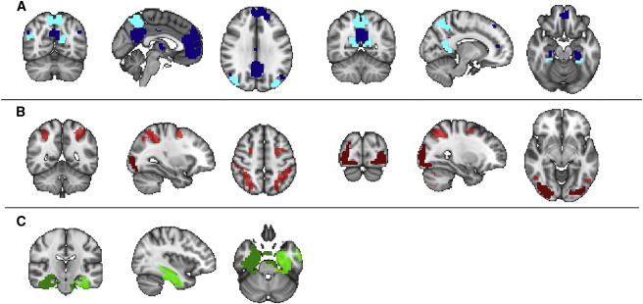

Slide 3
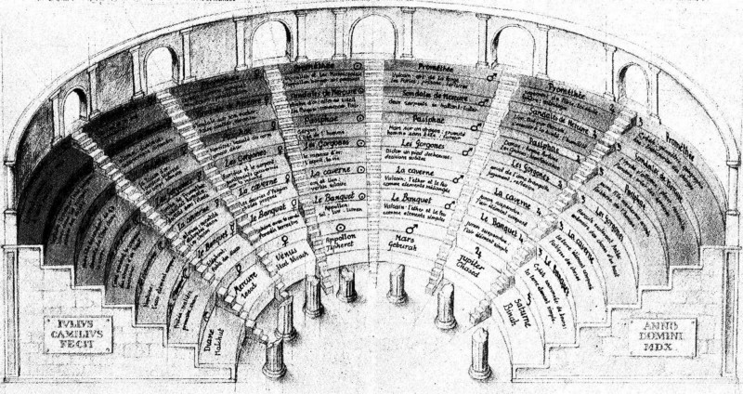

Slide 4
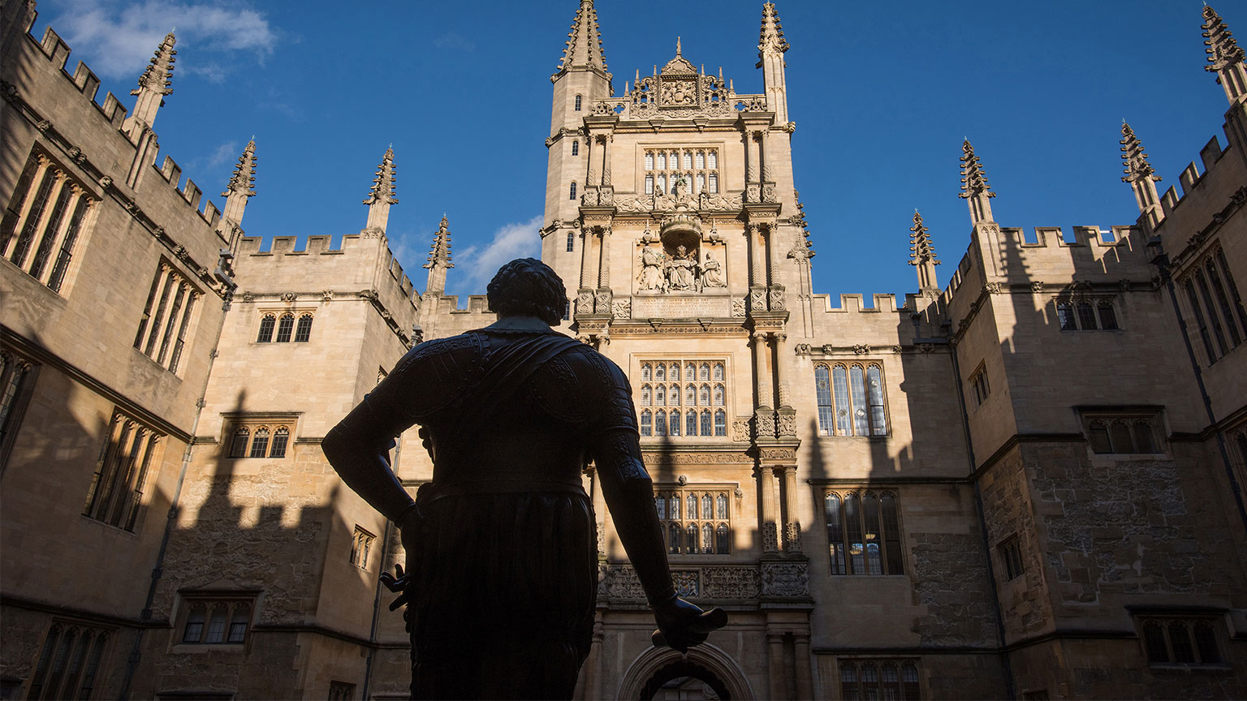
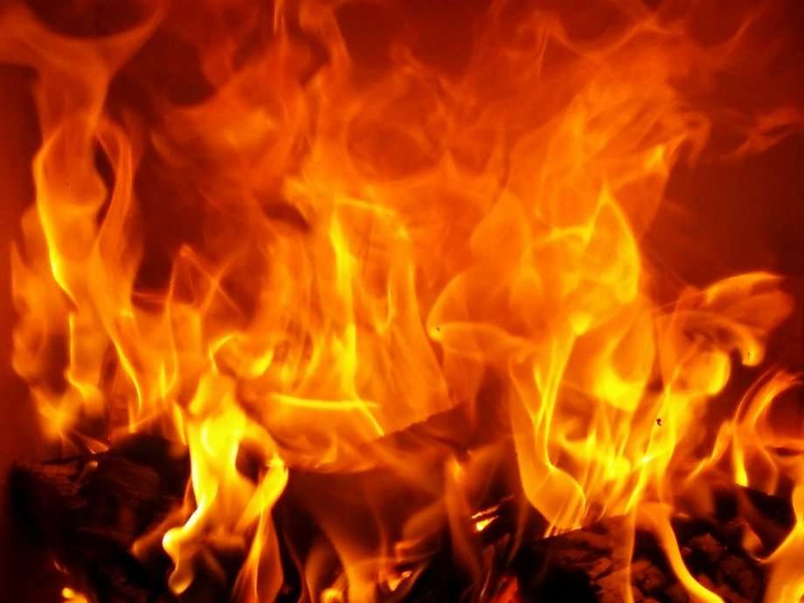
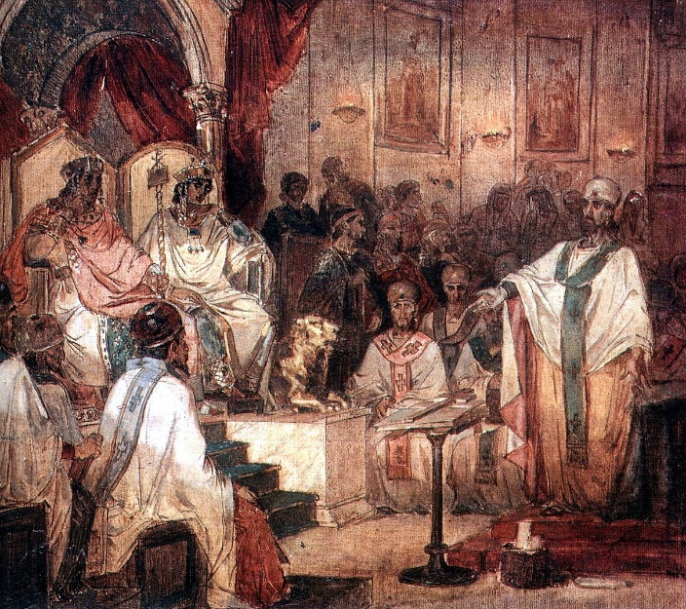

Slide 5
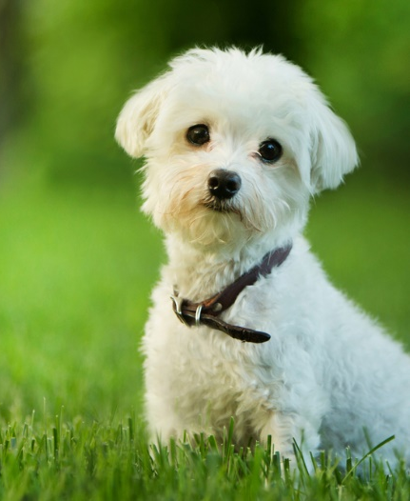
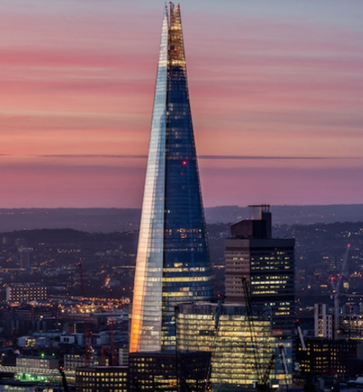
What do you get if you cross a dog with a skyscraper?
has fur
hard job cleaning windows
vertebrate
Strong reaction to baths
saves ground space
mammal
people inside
barks
Loves chomping bones
dampers to stay upright
built on strong foundations
Gives name to teeth/islands

Slide 6

