Slide 1




WE NEED TO BUILD A BETTER FUTURE:
why creativity matters
Dan Holloway

Slide 2
Extinction-level threats
Risk | At least 1 billion dead | Human extinction
Number killed by molecular nanotech weapons. | 10% | 5%
Total killed by superintelligent AI. | 5% | 5%
Total killed in all wars (including civil wars). | 30% | 4%
Number killed in the single biggest engineered pandemic. | 10% | 2%
Total killed in all nuclear wars. | 10% | 1%
Number killed in the single biggest nanotech accident. | 1% | 0.5%
Number killed in the single biggest natural pandemic. | 5% | 0.05%
Total killed in all acts of nuclear terrorism. | 1% | 0.03%
Overall risk of extinction prior to 2100 | n/a | 19%
source: 80000hours.org

Slide 3
New ideas
New ways of communicating
New forms of institution

Slide 4
Plant World
Animal
World
Geology
History of Ideas
My Knowledge
Human-Made World
Cosmology
Culture

Slide 5
Plant World
My knowledge
History of Ideas
Physical World
Animal
World
Cosmology
Human-Made World
Culture

Slide 6
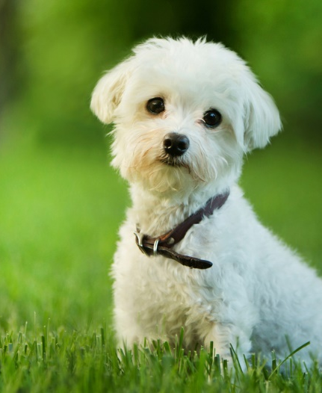
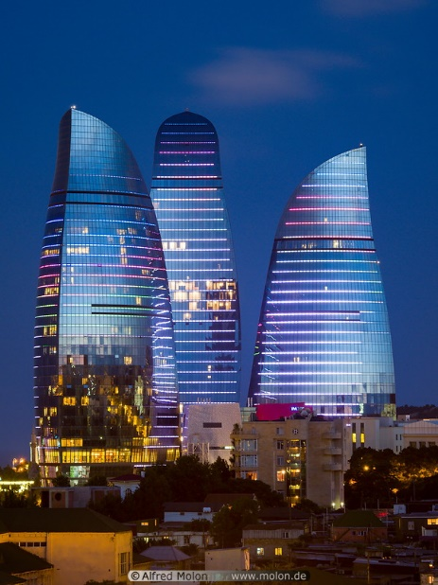
What do you get if you cross a dog with a skyscraper?
has fur
hard job cleaning windows
vertebrate
likes baths
saves ground space
mammal
people inside
barks
eats meat
dampers to stay upright
“best friend”
built on strong foundations
paws

Slide 7
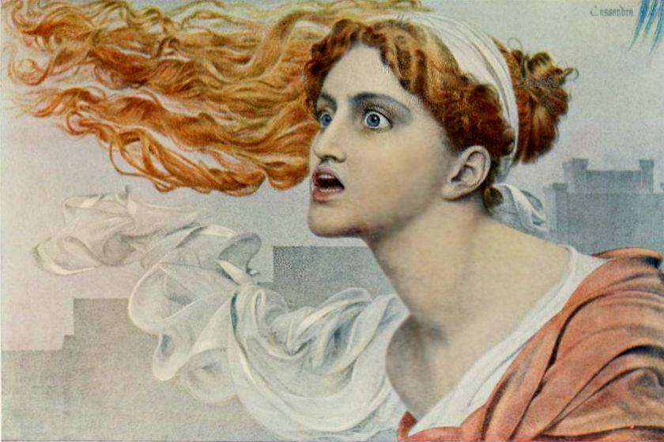

Slide 8
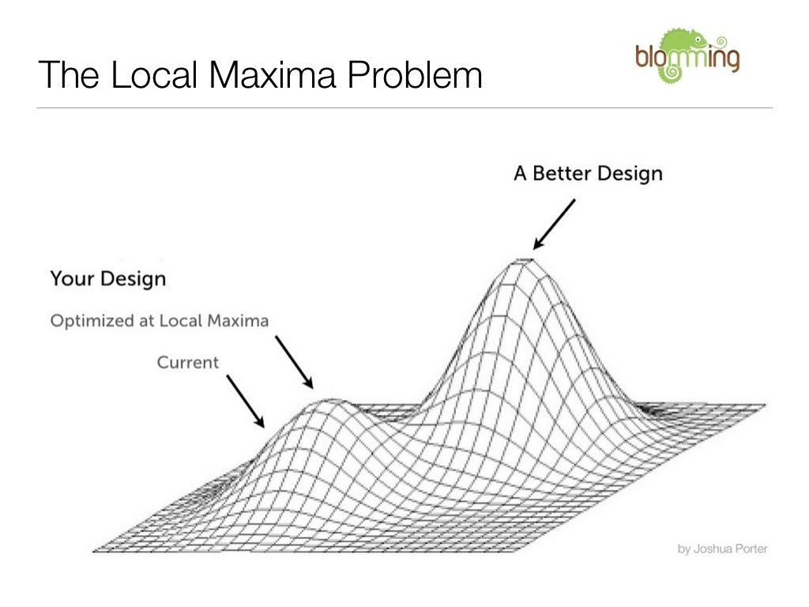

Slide 9
Forget that
Have you seen this?
Obvs
Have you seen this?
Forget that
Are you having a laugh?
We have to do this!
We have to do this!
Are you having a laugh?

Slide 10
New ideas
New ways of communicating
New forms of institution

Slide 11
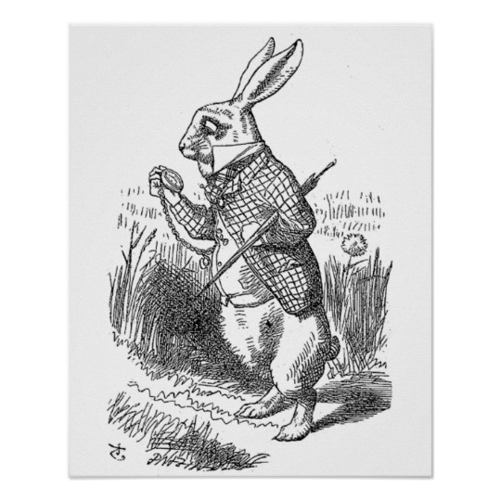

Slide 13
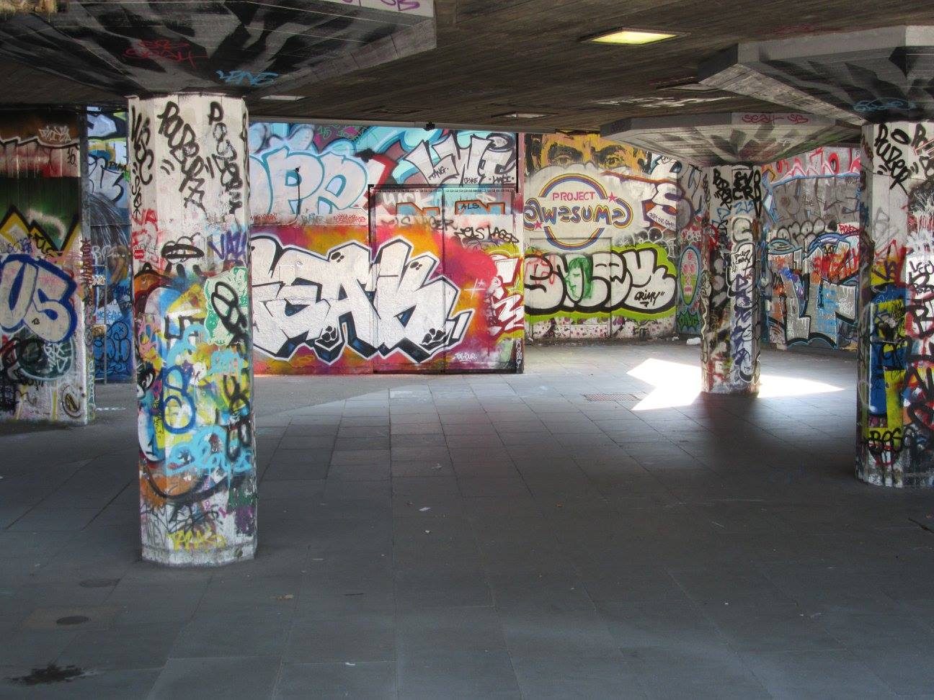

Slide 14
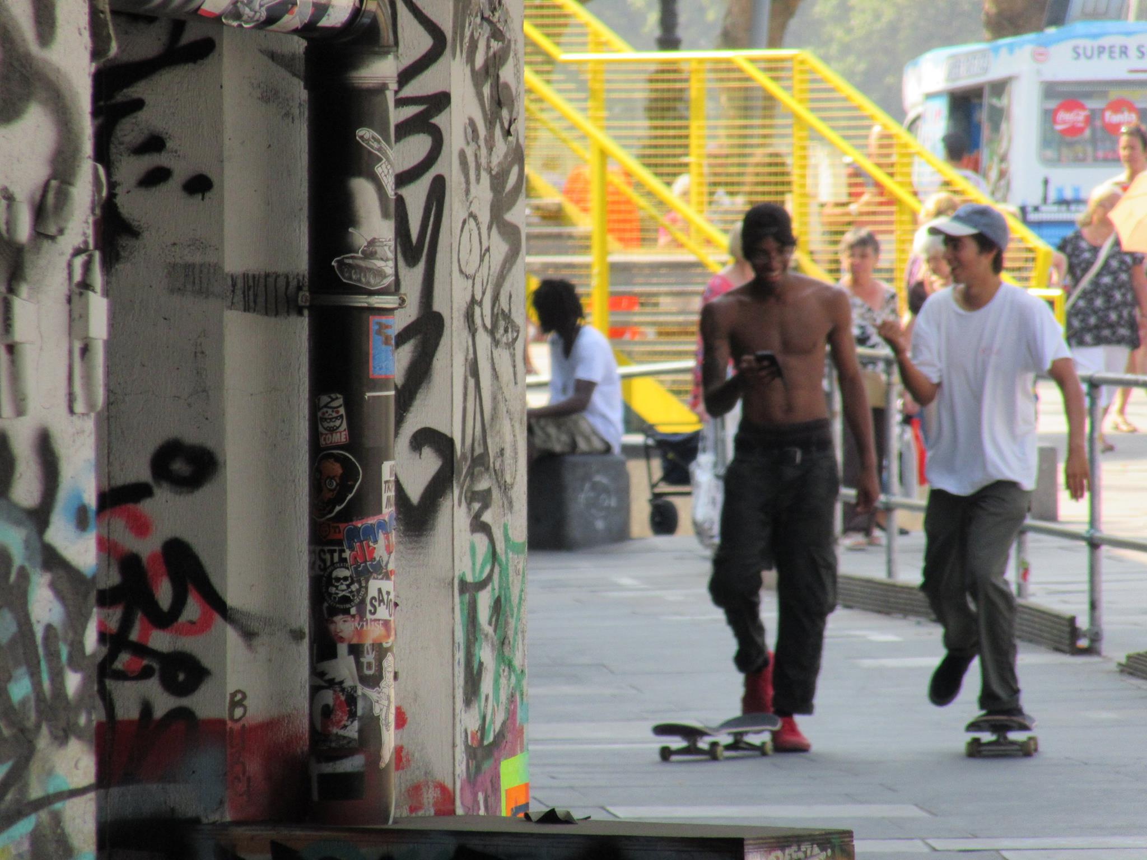

Slide 15
New ideas
New ways of communicating
New forms of institution

