Slide 1


Slide 2
Extinction-level threats
Risk | At least 1 billion dead | Human extinction
Number killed by molecular nanotech weapons. | 10% | 5%
Total killed by superintelligent AI. | 5% | 5%
Total killed in all wars (including civil wars). | 30% | 4%
Number killed in the single biggest engineered pandemic. | 10% | 2%
Total killed in all nuclear wars. | 10% | 1%
Number killed in the single biggest nanotech accident. | 1% | 0.5%
Number killed in the single biggest natural pandemic. | 5% | 0.05%
Total killed in all acts of nuclear terrorism. | 1% | 0.03%
Overall risk of extinction prior to 2100 | n/a | 19%
source: 80000hours.org

Slide 3
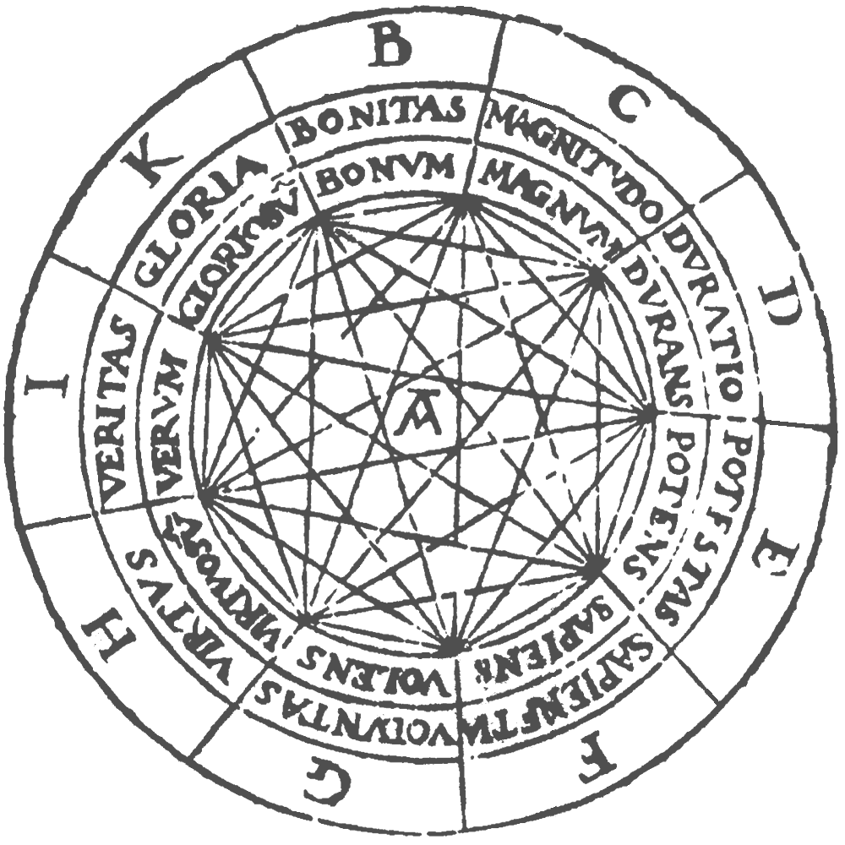

Slide 4
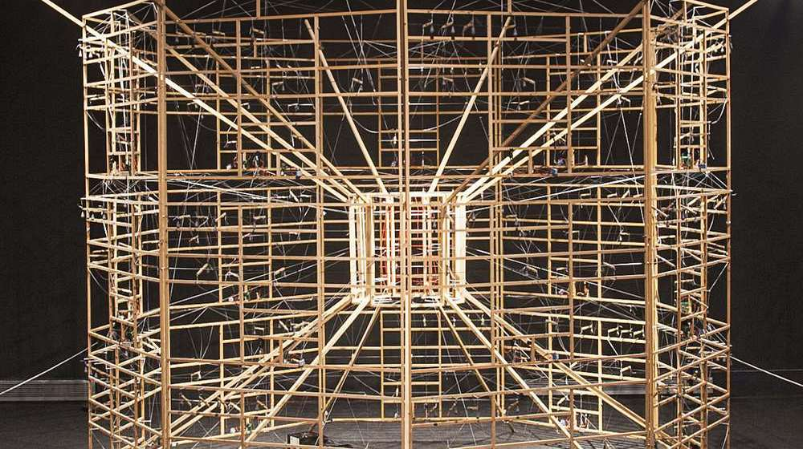
"Ramon Llull thought that all knowledge is networked”
Amador Vega

Slide 5
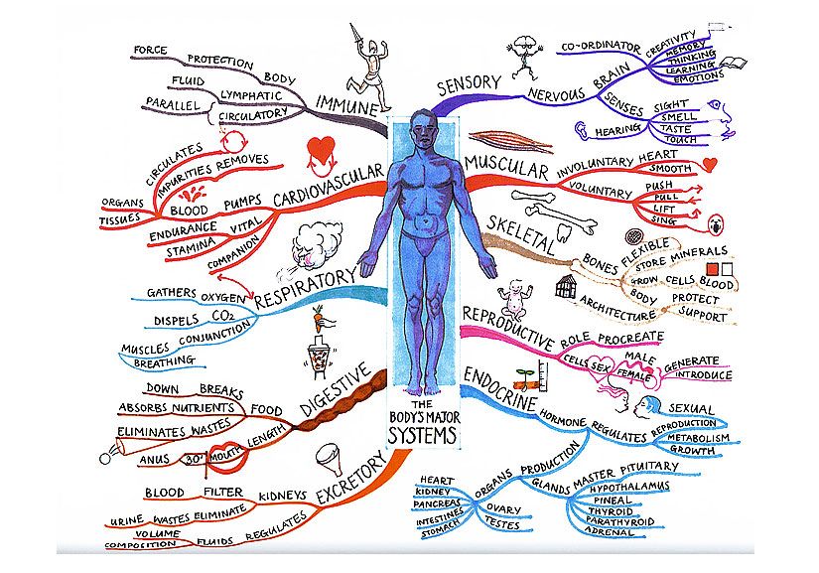
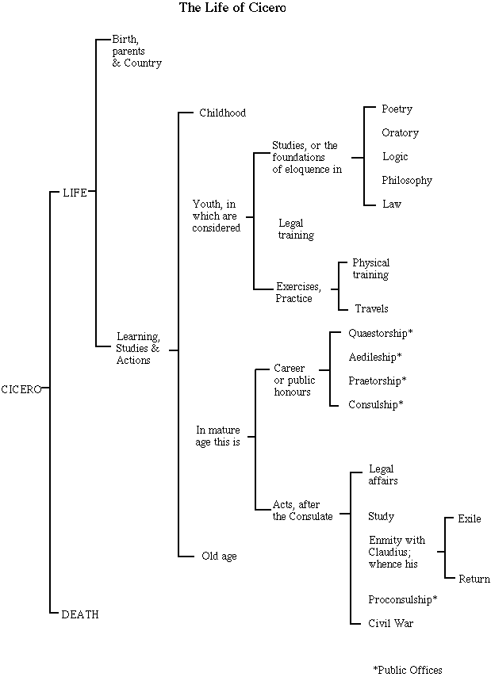

Slide 6
Plant World
Animal
World
Geology
My Knowledge
History of Ideas
Human-Made World
Cosmology
Culture

Slide 7
Plant World
My knowledge
History of Ideas
Physical World
Animal
World
Cosmology
Human-Made World
Culture

Slide 8
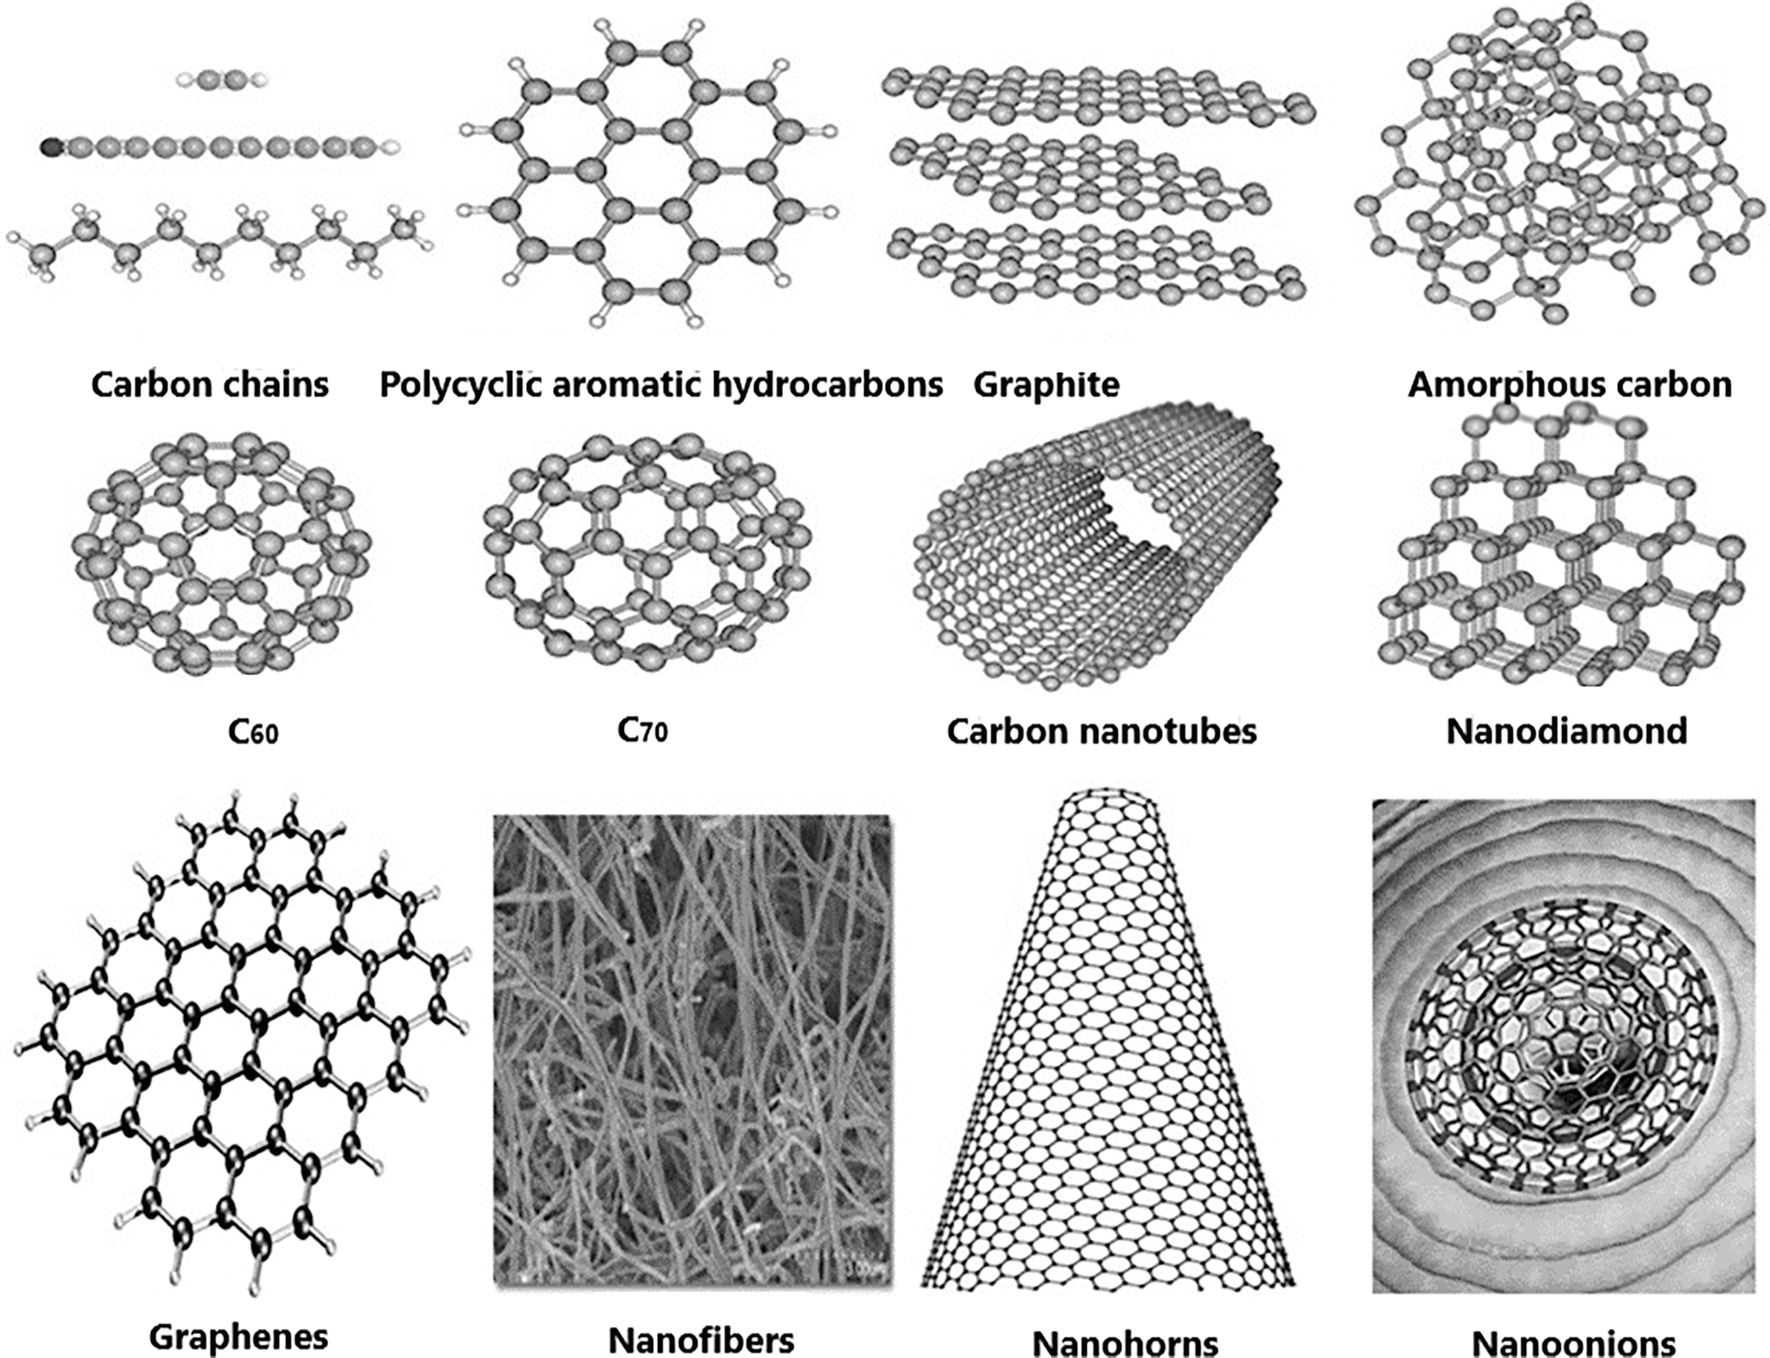
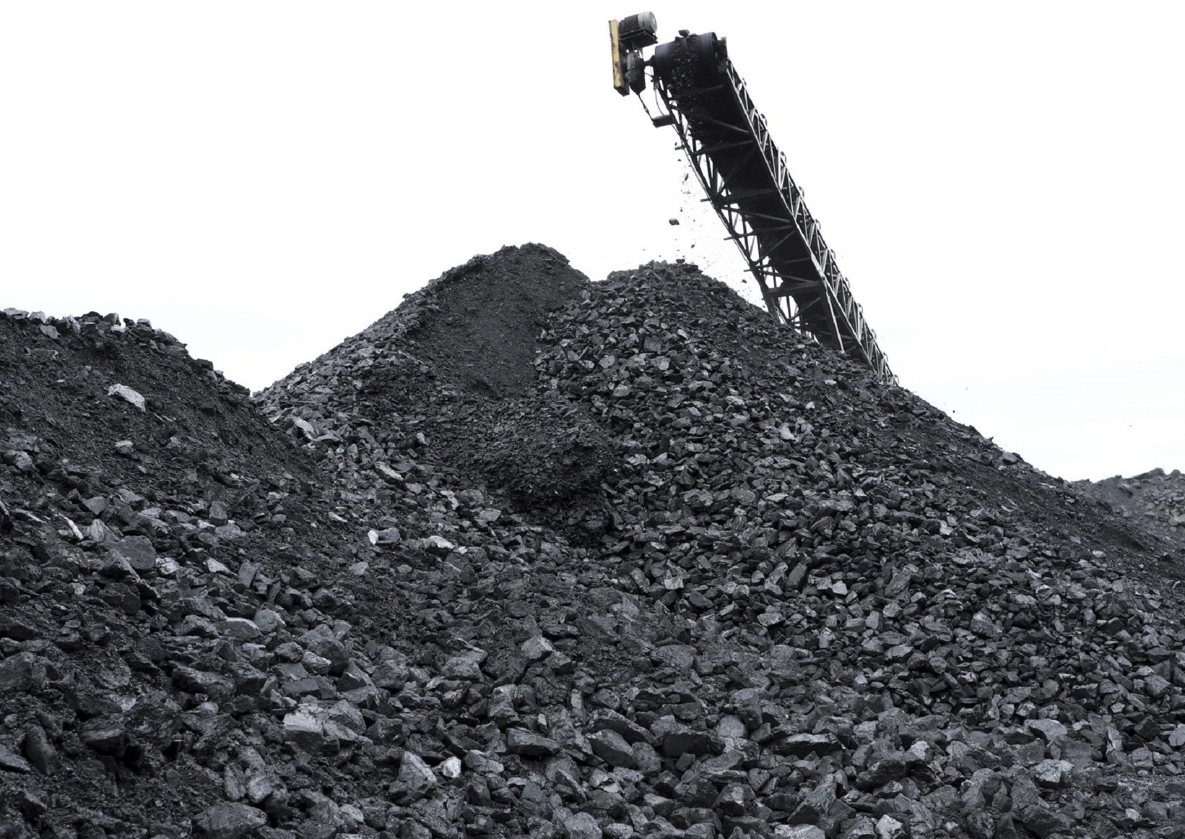

Slide 9
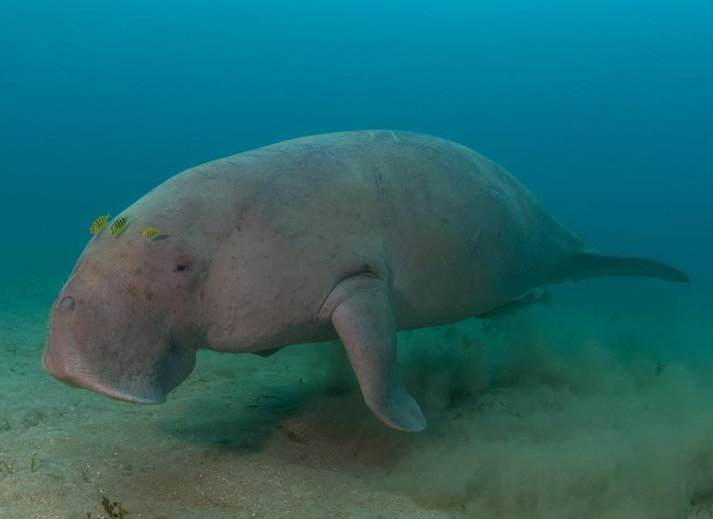
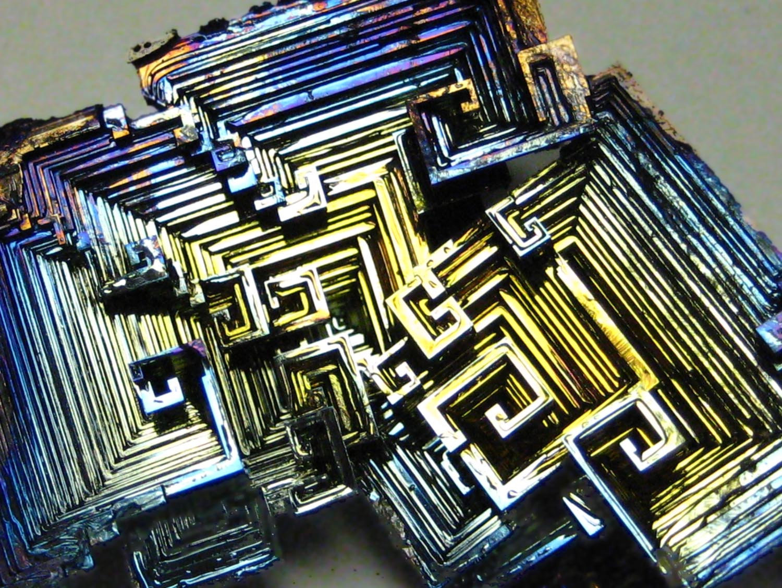

Slide 10
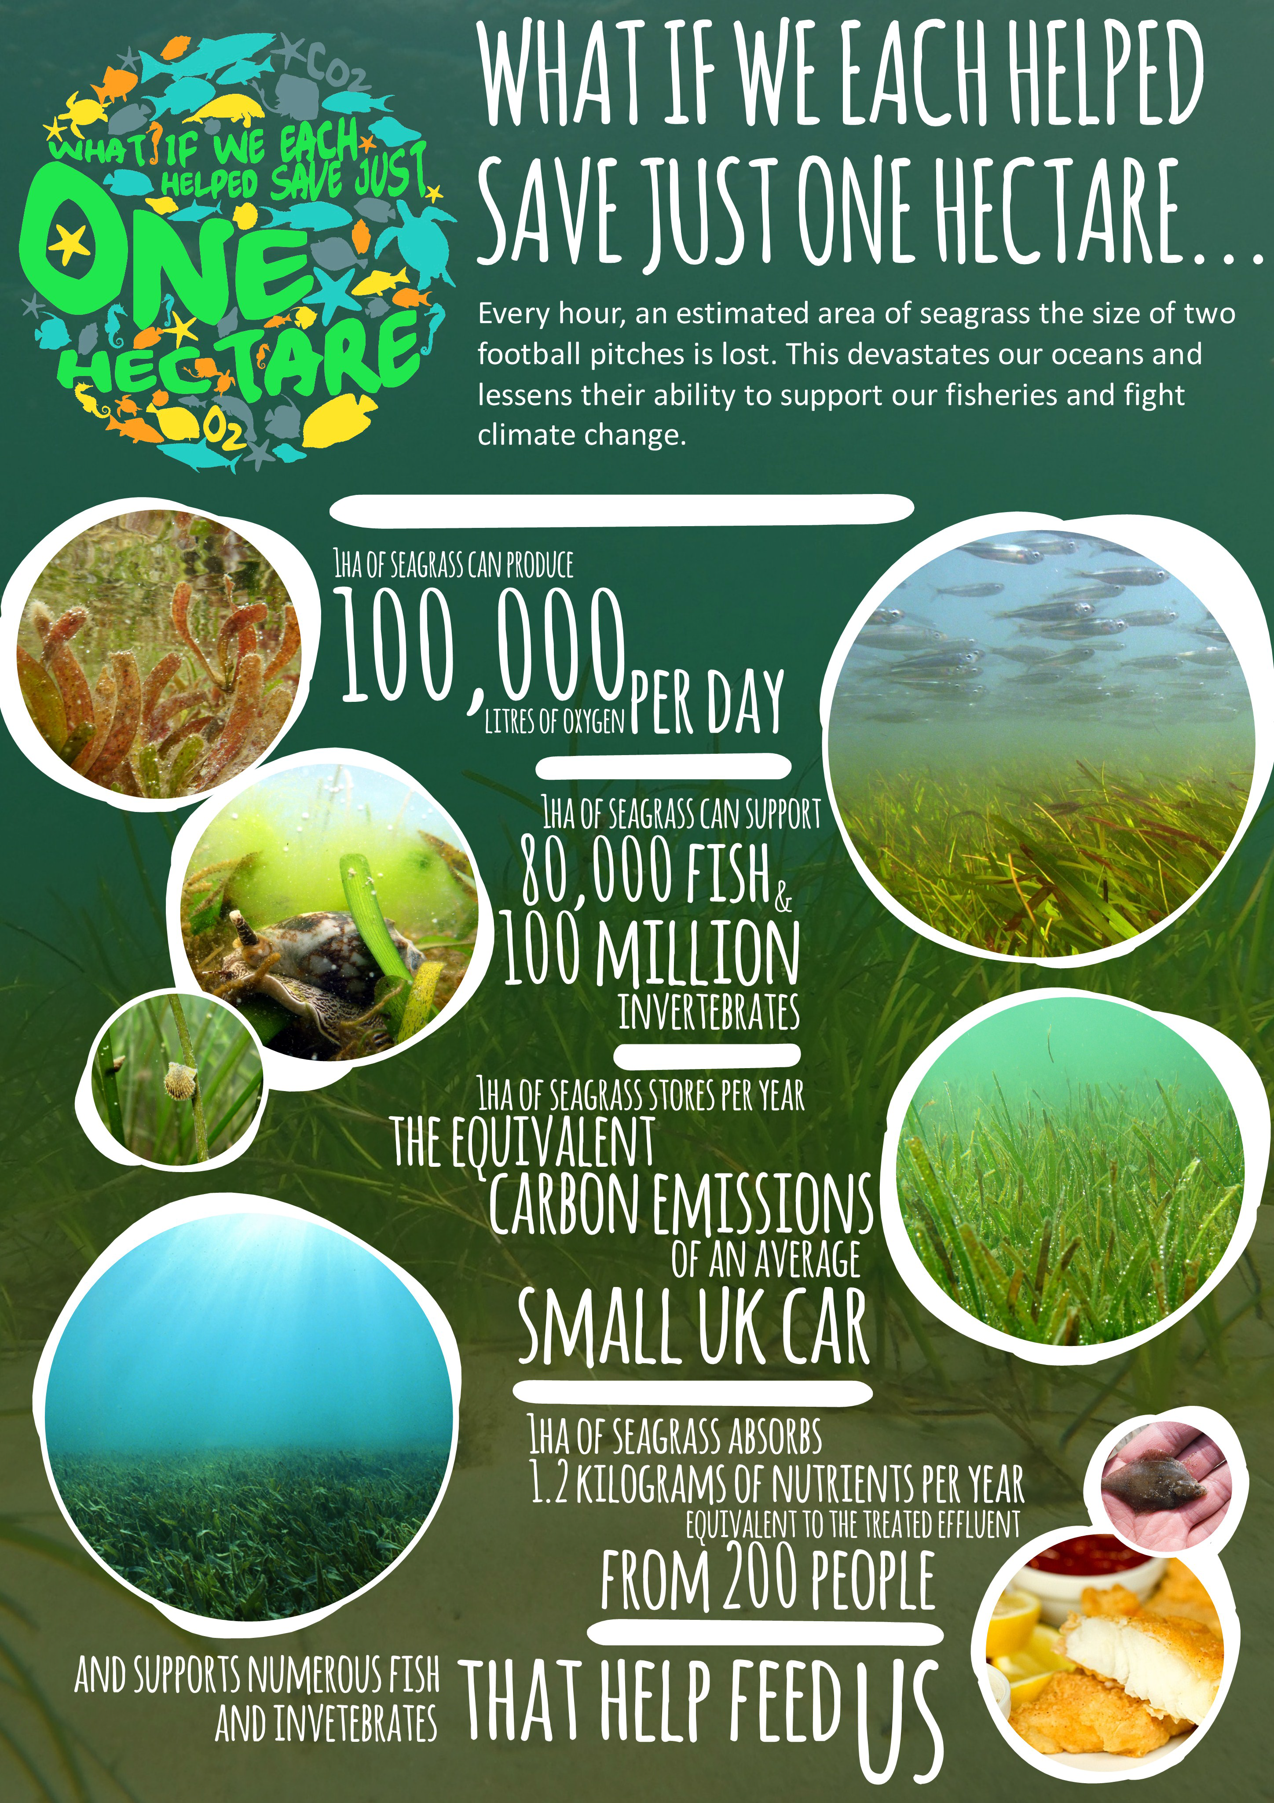
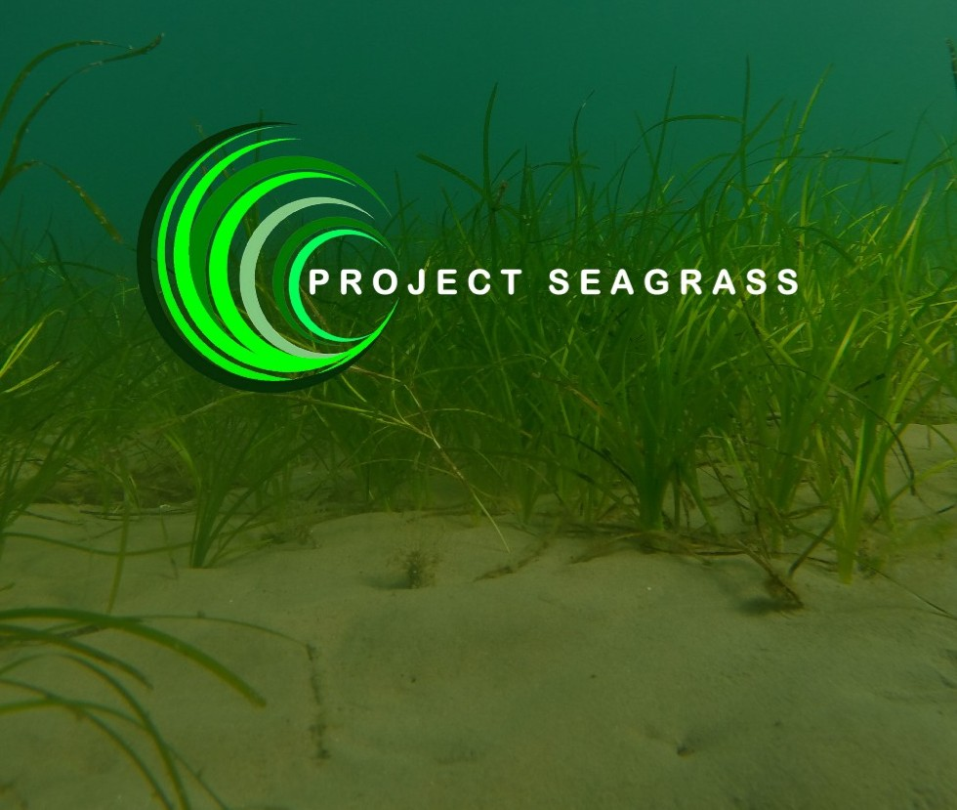

Slide 11


What do you get if you cross a dog with a skyscraper?
has fur
hard job cleaning windows
vertebrate
likes baths
saves ground space
mammal
people inside
barks
eats meat
dampers to stay upright
“best friend”
built on strong foundations
paws

Slide 12
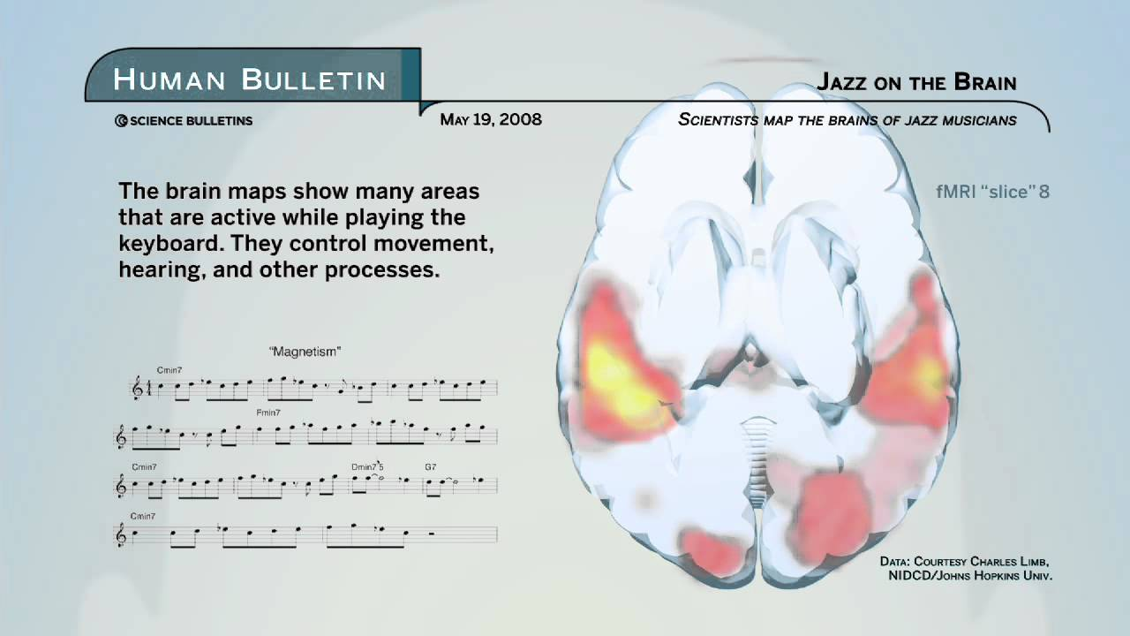

Slide 13
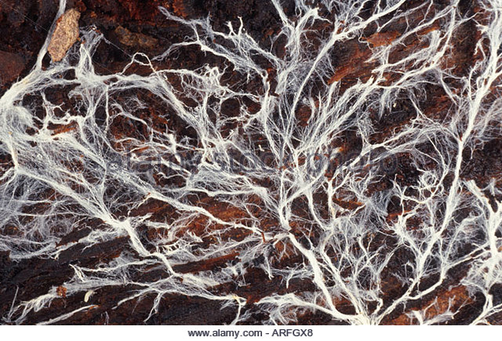

Slide 14

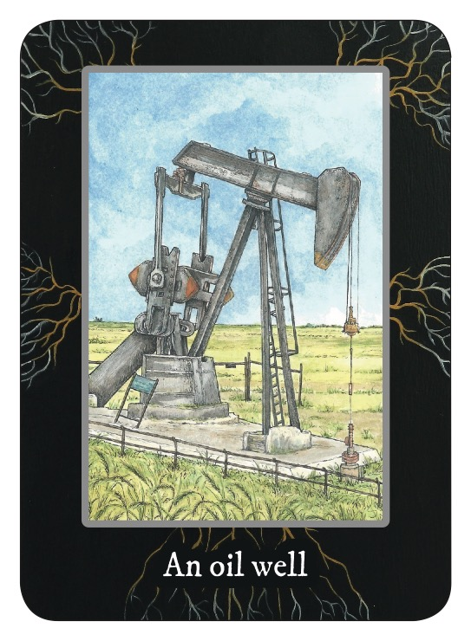
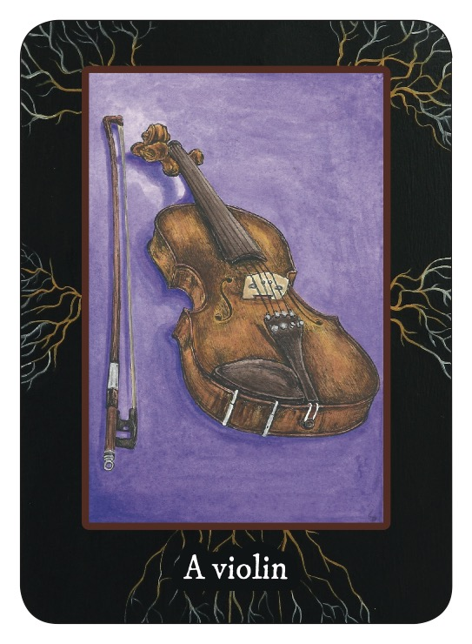
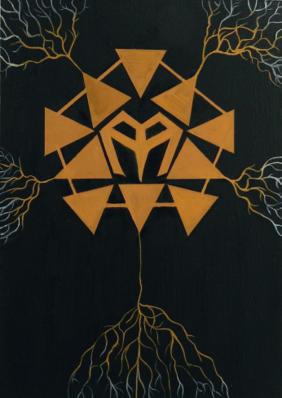

Slide 15
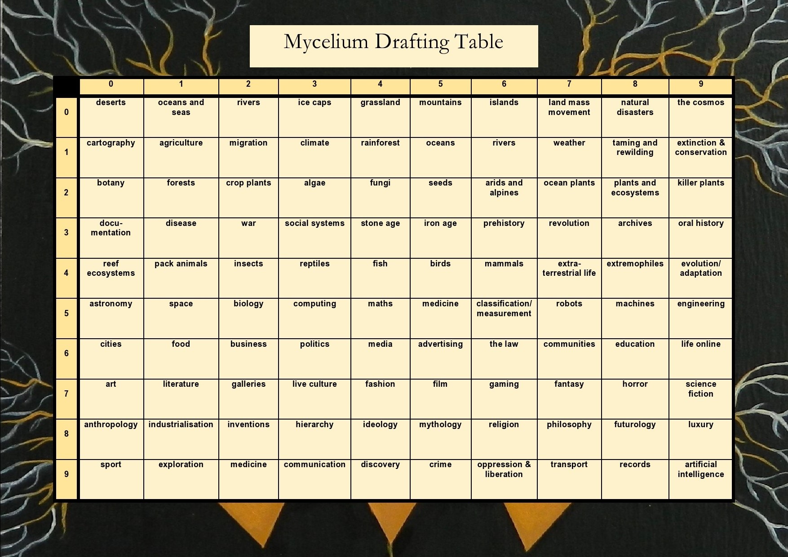

Slide 16
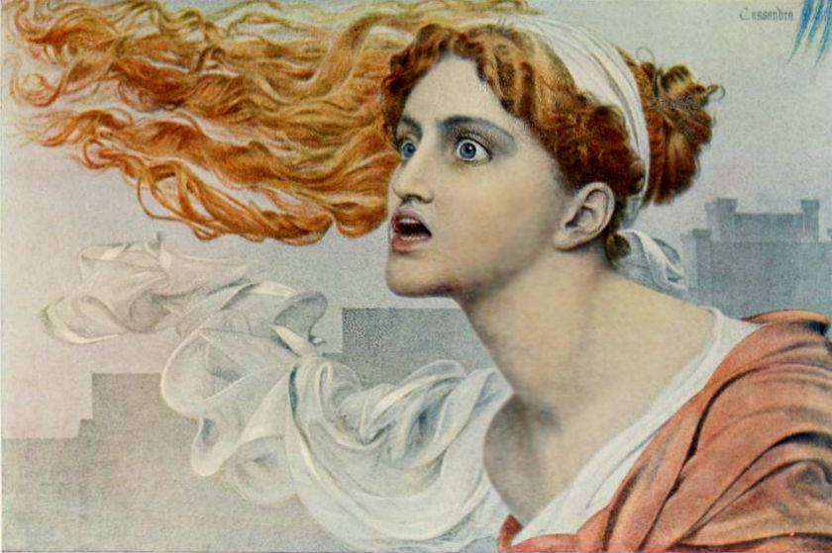

Slide 17
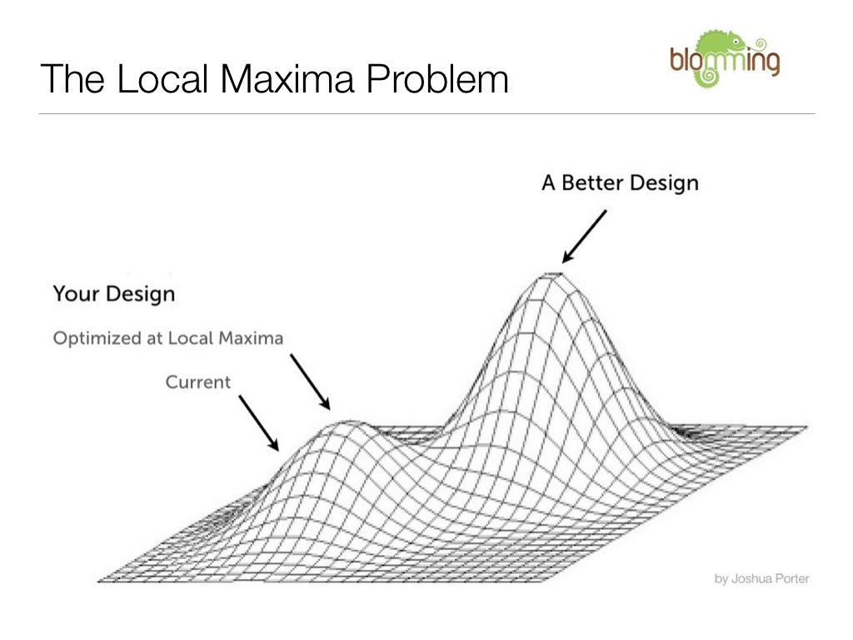

Slide 18
**** that
Have you seen this?
Obvs
Have you seen this?
**** that
Are you having a laugh?
We have to do this!
We have to do this!
Are you having a laugh?

Slide 19
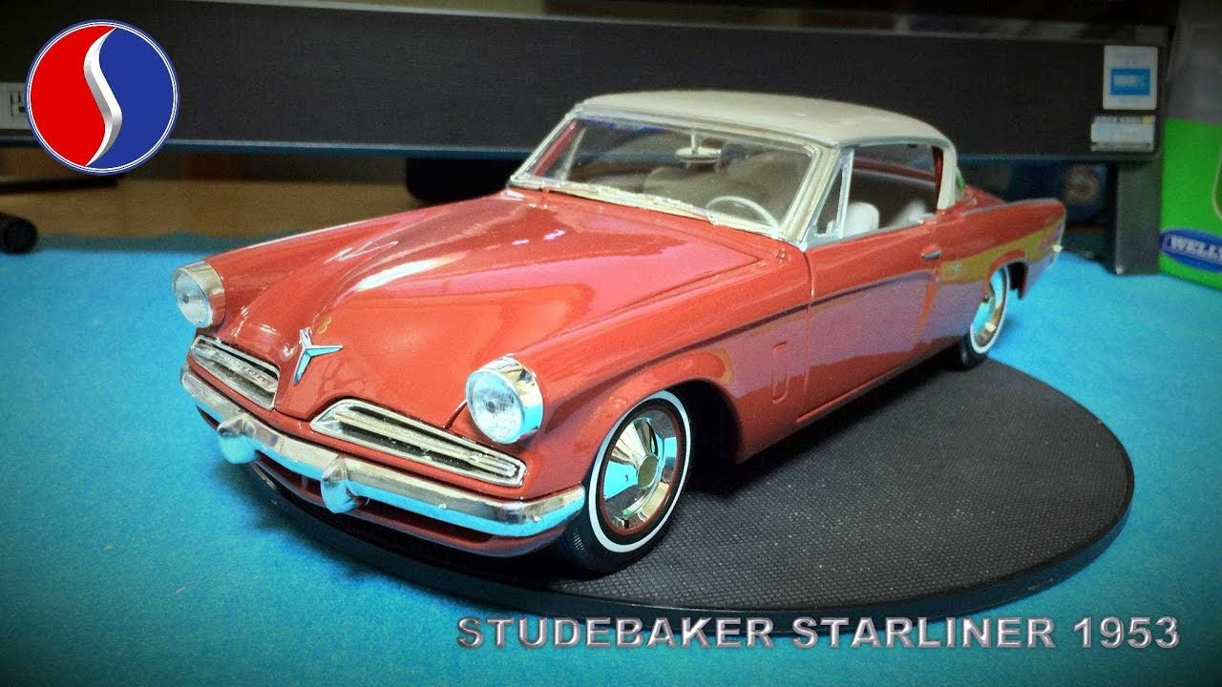

Slide 21
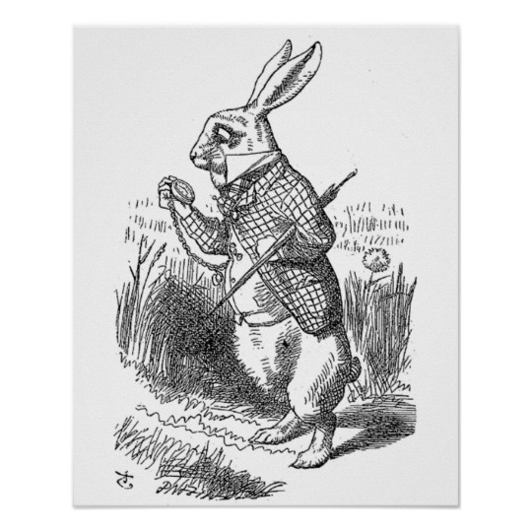

Slide 22
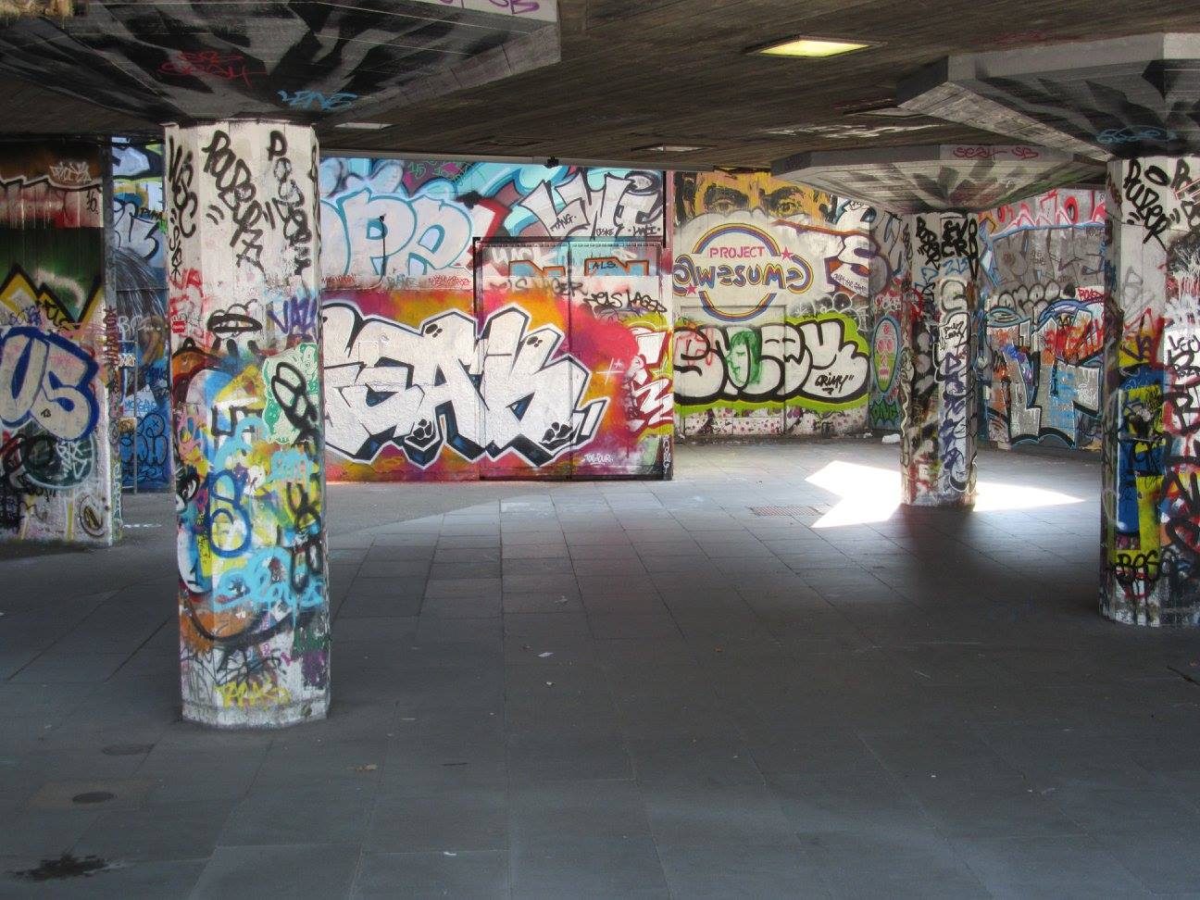

Slide 23


Slide 24
Do better with boxes
All the things
My box
Outside my box

