Slide 1


EXQUISITE LADDERS:
Bending the Neurotypical Academy’s Straight Lines
Dan Holloway
University of Oxford

Slide 2
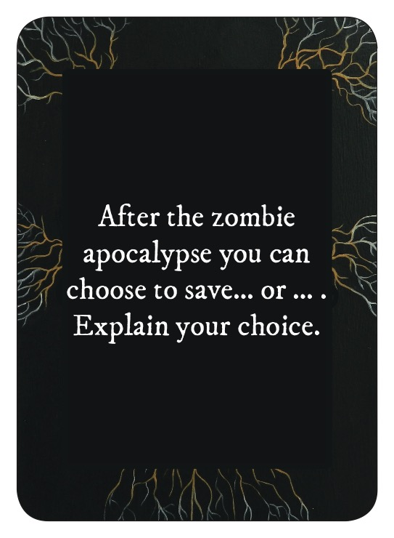

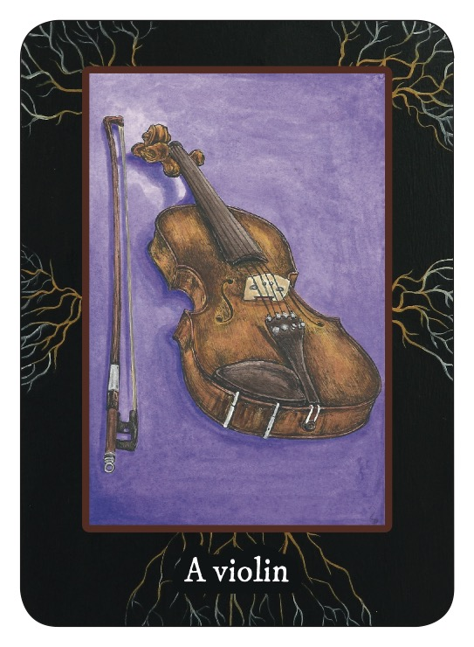

Slide 3
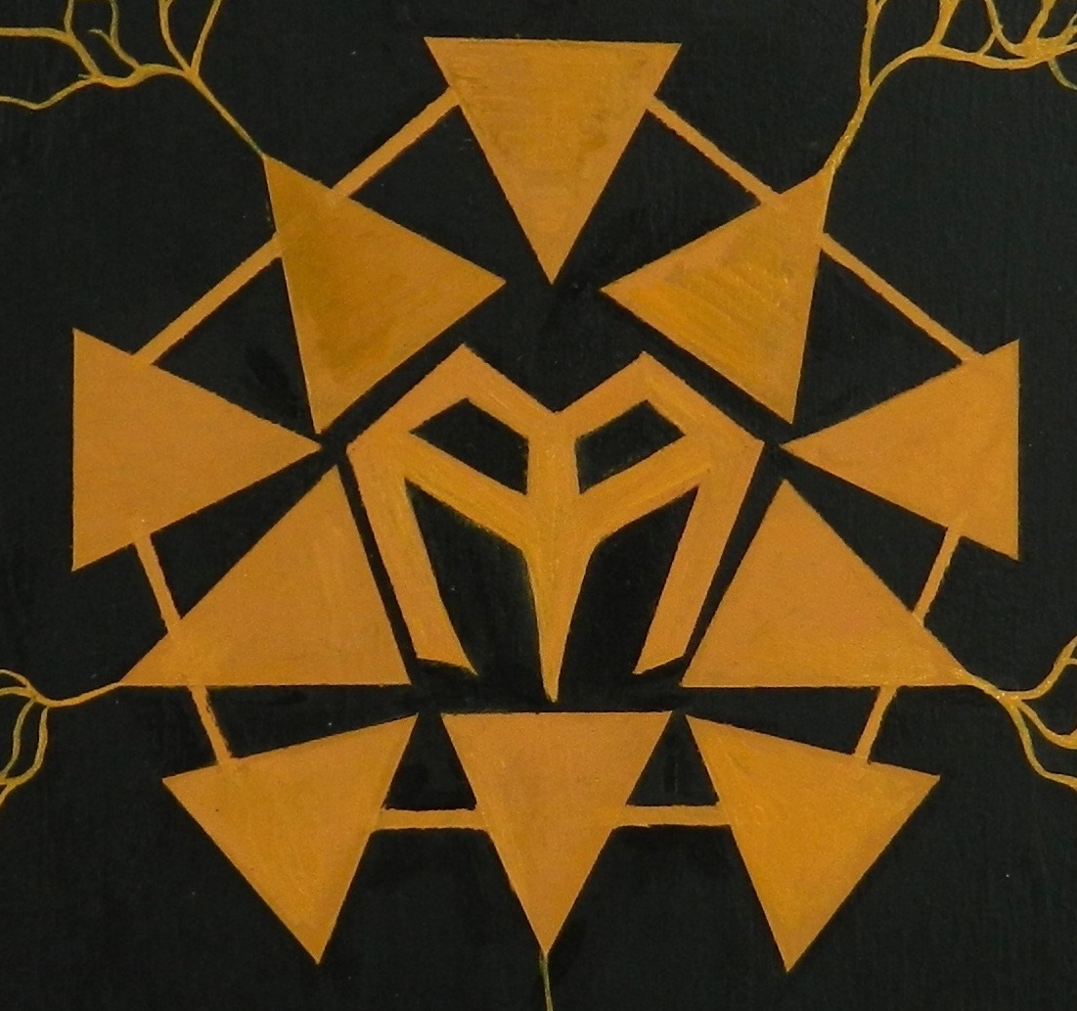

Slide 4
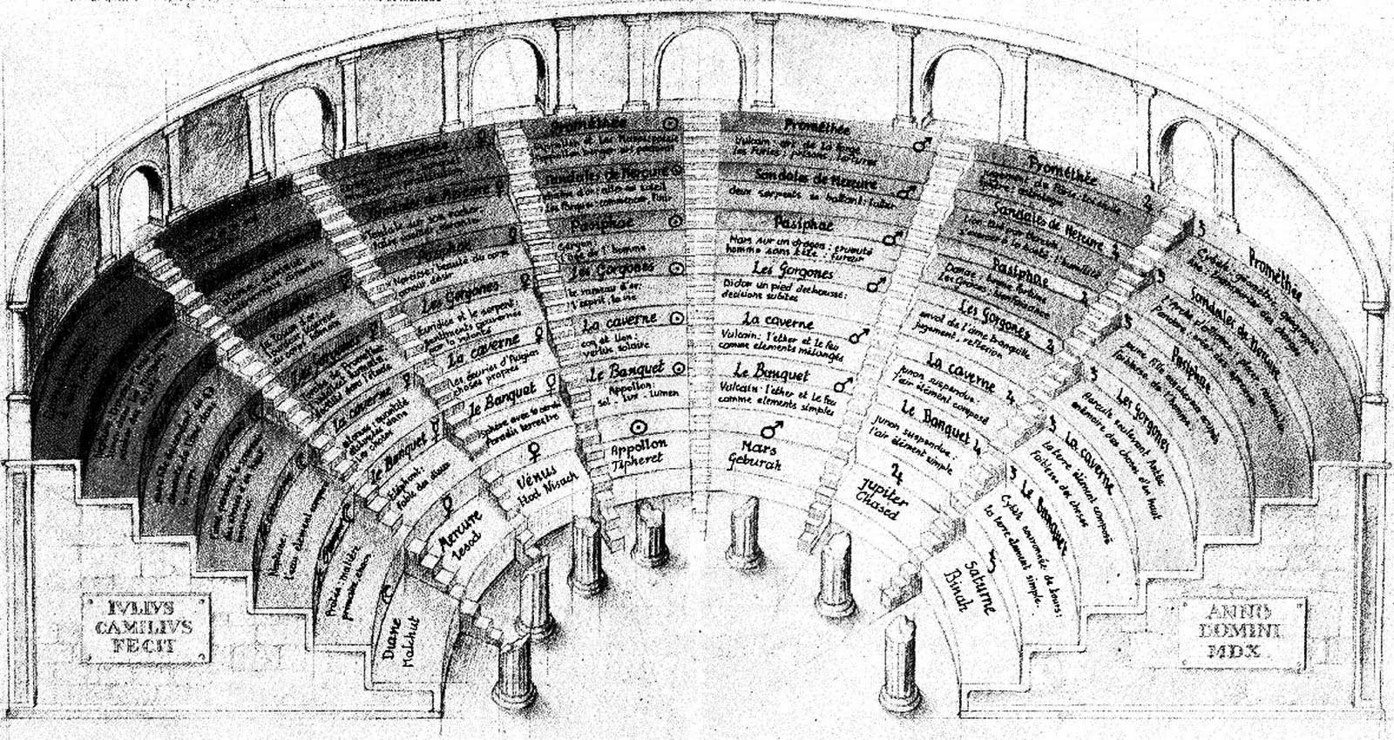

Slide 5
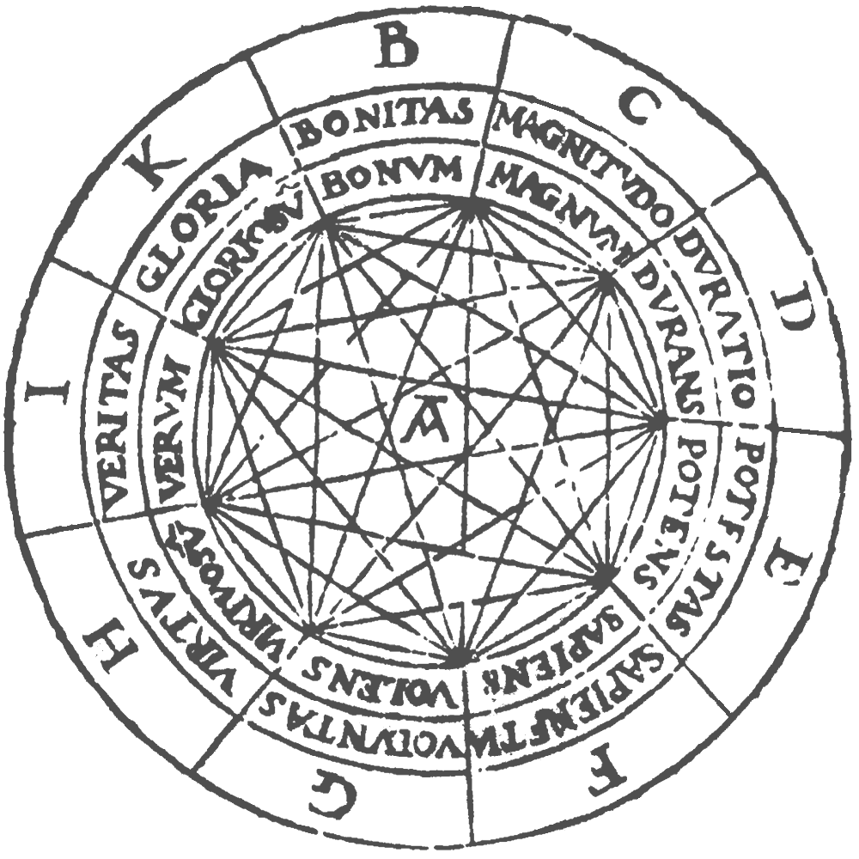

Slide 6
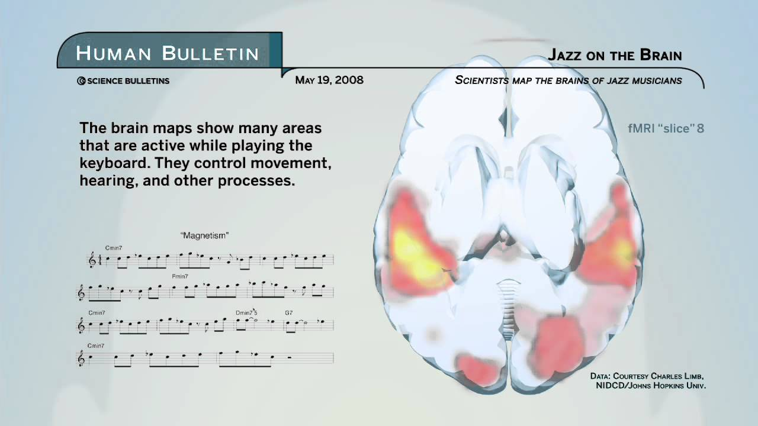

Slide 7


Slide 9

IMAGE: TERRY YARROW PHOTOGRAPHY

Slide 10
The three myths of linearity
The linear CV
The linear output
The linear person

Slide 11
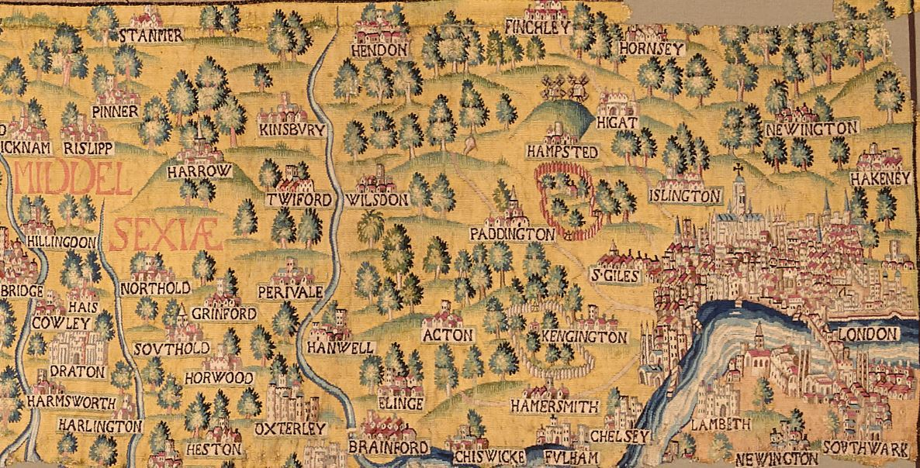

Slide 12
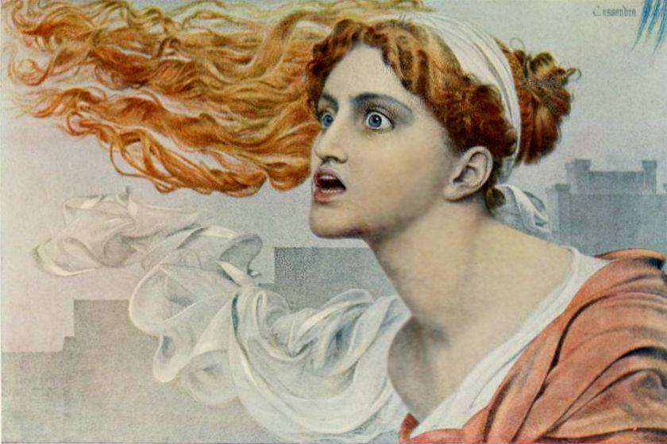

Slide 13
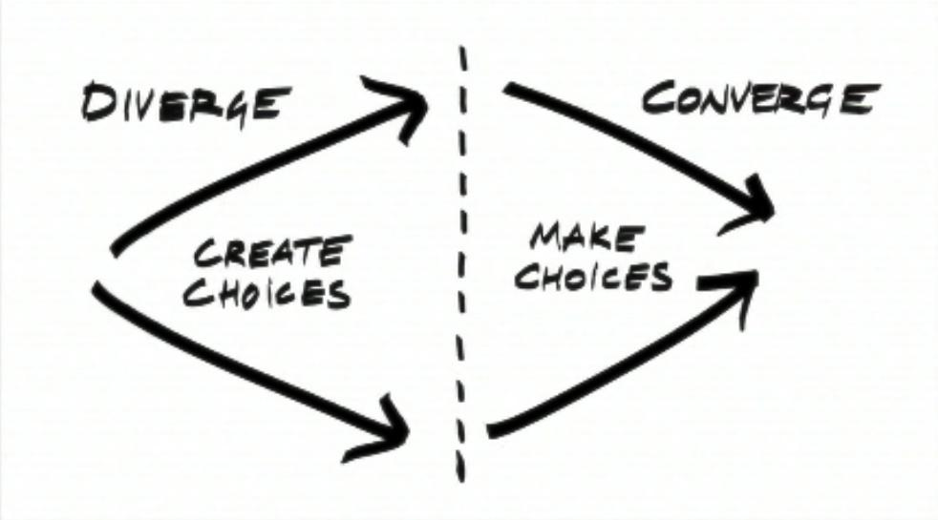

Slide 14
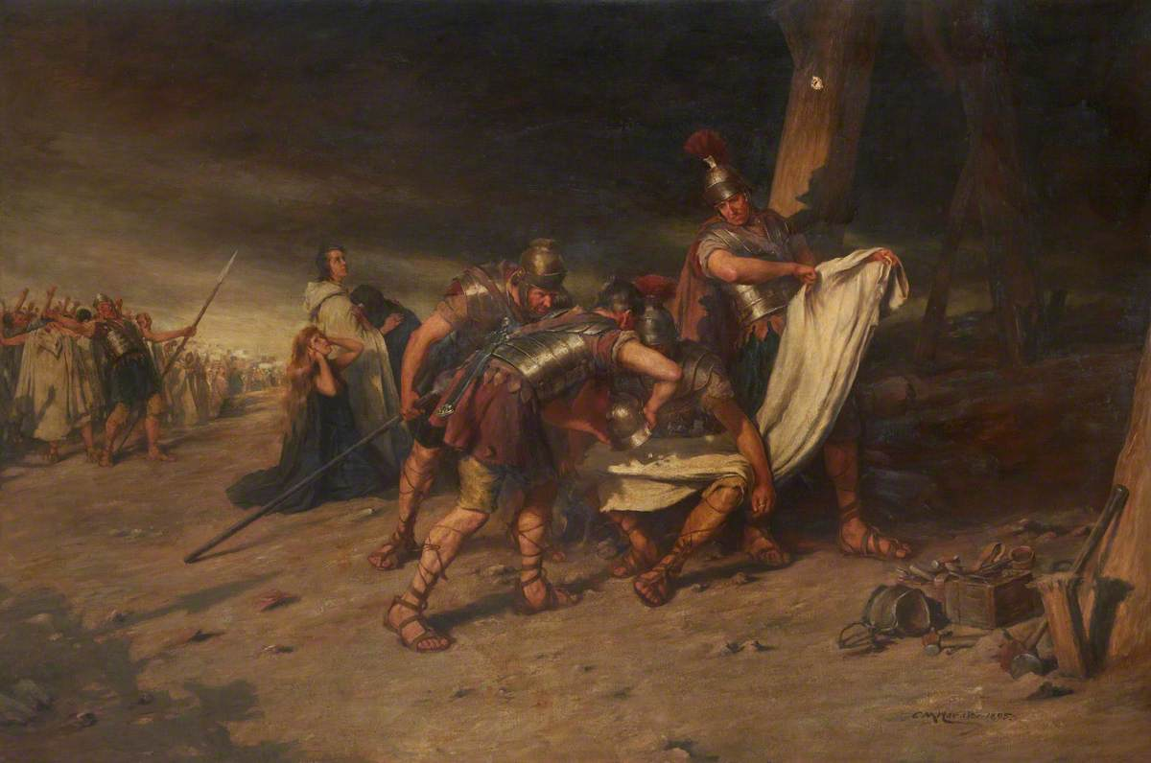

Slide 15
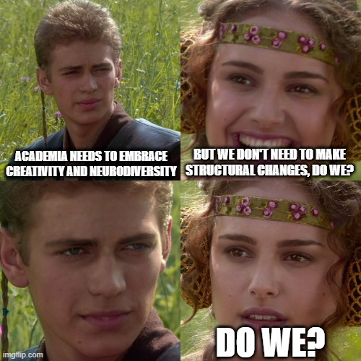

Slide 16
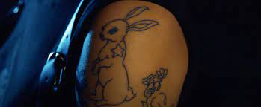

Slide 17


Slide 18
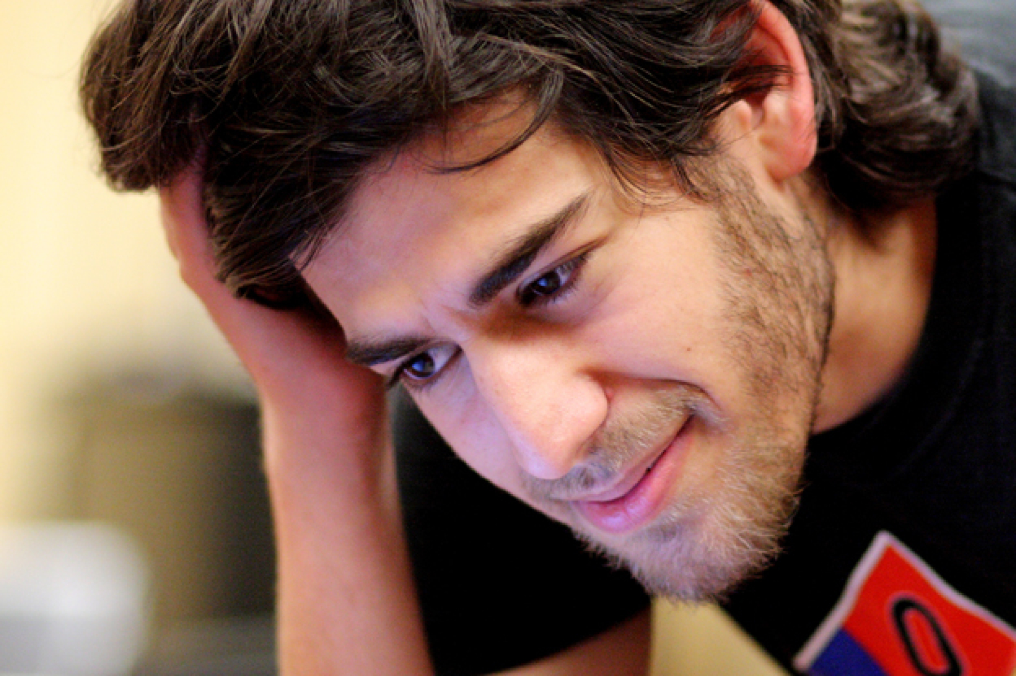
“An institution is not truly open until
somebody you could never even imagine
exists walks through the door.”
Danny O’Brien, Electronic Frontier Foundation,
on 14 Aaron Swartz working at Stanford
with Tim Berners-Lee

Slide 19


Scan the QR code or go to
https://rogueinterrobang.com/2021/10/05/exquisite-ladders/
To
Download resources from this talk
Full transcript and reading list
Slides
Full colour printable PDF of Mycelium
Find the link to my book on creativity,
Our Dreams Make Different Shapes

